Slide 1
Big Data
Paper report presentation

Slide 2

Diameter problem
Given a finite set S of n points in R^{d}, find D(S) =$\max_{∀p,q∈S} (||p−q||$)

Slide 3
Diameter problem
Given a finite set S of n points in R^{d}, find D(S) =$\max_{∀p,q∈S} (||p−q||$)
x
y
D(S)
S in R²

Slide 4
Diameter problem
Literature
O(n log n) exact algorithm for d <= 3
For d > 3, only approximation algorithm runs in near-linear time

Slide 5
Diameter problem
Brute force
Iterate through O(n²) pair (p, q) and maintain maximal ||p - q||
Takes O(d*n²) time, not practical in higher dimensions

Slide 6

Diameter problem
2-approximation
Pick any point p $∈$ S, find D* = $\max_{q∈S}$ (||p - q||)
D* <= D(S) <= 2D*, D* is a 2-approximation of diameter of set S
Time complexity O(d*n)

Slide 7
Diameter problem
2-approximation
Pick any point p $∈$ S, find D* = $\max_{q∈S}$ (||p - q||)
D* <= D(S) <= 2D*, D* is a 2-approximation of diameter of set S
Time complexity O(d*n)
q
D*
p

Slide 8
Diameter problem
grid
Decompose space into net of grids
Rounding points into grid points

Slide 9
Diameter problem
grid
Decompose space into net of grids
Rounding points into grid points
D(S)

Slide 10
Diameter problem
grid
Decompose space into net of grids
Rounding points into grid points
D(S)

Slide 11
Diameter problem
grid
Decompose space into net of grids
Rounding points into grid points

Slide 12




Diameter problem
grid
Decompose space into net of grids, Rounding points into grid points
Error introduced = O(${εD}^{∗}$) = O($ε$D(S))
$$\frac{{εD}^{∗}}{\sqrt{2}}$$
$${εD}^{∗}$$
(In R^{d}, $\frac{{εD}^{∗}}{\sqrt{d}}$)

Slide 13
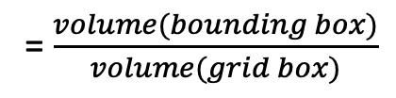

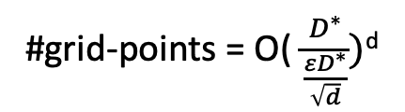
Diameter problem
grid
Decompose space into net of grids, Rounding points into grid points
Error introduced = O(${εD}^{∗}$) = O($ε$D(S))
$$\frac{{εD}^{∗}}{\sqrt{2}}$$
$${εD}^{∗}$$
#grid-points = O( $\frac{D^{∗}}{\frac{{εD}^{∗}}{\sqrt{d}}})$^{d}
(In R^{d}, $\frac{{εD}^{∗}}{\sqrt{d}}$)
= O( $\frac{\sqrt{d}}{ε})$^{d}
= $\frac{volume(bounding box)}{volume(grid box)}$

Slide 14
Diameter problem
Direction partitioning [Agarwal at 1992]
Partition space into unit direction vectors
Find extreme points along each direction vector
D(S)

Slide 15

Diameter problem
Direction partitioning [Agarwal at 1992]
Partition space into unit direction vectors
Find extreme points along each direction vector
1) V = {$∀i∈\left[0,t\right):v_{i}=(cos\frac{2πi}{t},sin\frac{2πi}{t})$}
D(S)

Slide 16
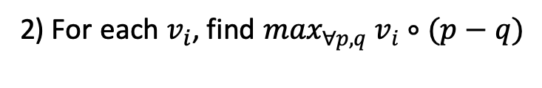
Diameter problem
Direction partitioning [Agarwal at 1992]
Partition space into unit direction vectors
Find extreme points along each direction vector
1) V = {$∀i∈\left[0,t\right):v_{i}=(cos\frac{2πi}{t},sin\frac{2πi}{t})$}
2) For each $v_{i}$, find $\max_{∀p,q}$ $v_{i}∘(p−q)$
D(S)

Slide 17
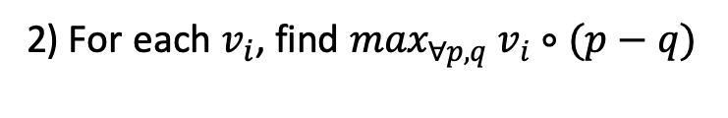
Diameter problem
Direction partitioning [Agarwal at 1992]
Partition space into unit direction vectors
Find extreme points along each direction vector
1) V = {$∀i∈\left[0,t\right):v_{i}=(cos\frac{2πi}{t},sin\frac{2πi}{t})$}
q’
2) For each $v_{i}$, find $\max_{∀p,q}$ $v_{i}∘(p−q)$
P’

Slide 18
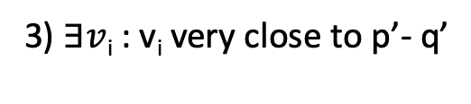

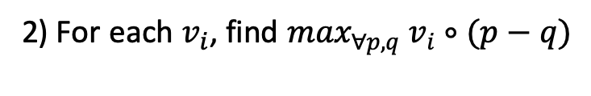
Diameter problem
Direction partitioning [Agarwal at 1992]
Partition space into unit direction vectors
Find extreme points along each direction vector
1) V = {$∀i∈\left[0,t\right):v_{i}=(cos\frac{2πi}{t},sin\frac{2πi}{t})$}
q’
$$θ$$
2) For each $v_{i}$, find $\max_{∀p,q}$ $v_{i}∘(p−q)$
3) $∃v$_{i} : v_{i} very close to p’- q’
P’

Slide 19
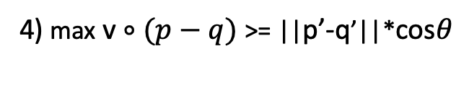
Diameter problem
Direction partitioning [Agarwal at 1992]
Partition space into unit direction vectors
Find extreme points along each direction vector
1) V = {$∀i∈\left[0,t\right):v_{i}=(cos\frac{2πi}{t},sin\frac{2πi}{t})$}
q’
$$θ$$
2) For each $v_{i}$, find $\max_{∀p,q}$ $v_{i}∘(p−q)$
3) $∃v$_{i} : v_{i} very close to p’- q’
4) max v $∘(p−q)$ >= ||p’-q’||*cos$θ$
P’

Slide 20

Diameter problem
Direction partitioning algorithm for computing diameter in R²
Let V = {$∀i∈\left[0,t\right):v_{i}=(cos\frac{2πi}{t},sin\frac{2πi}{t})$}, a set of t unit direction vectors

Slide 21
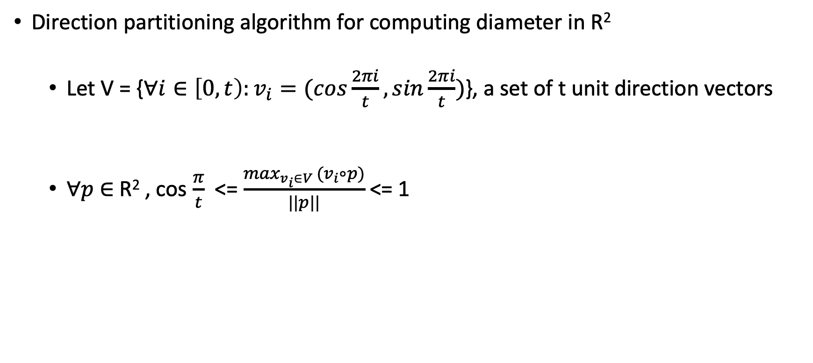
Diameter problem
Direction partitioning algorithm for computing diameter in R²
Let V = {$∀i∈\left[0,t\right):v_{i}=(cos\frac{2πi}{t},sin\frac{2πi}{t})$}, a set of t unit direction vectors
$∀p$ $∈$ R² , cos $\frac{π}{t}$ <= $\frac{\max_{v_{i}∈V }(v_{i}∘p)}{||p||}$<= 1

Slide 22
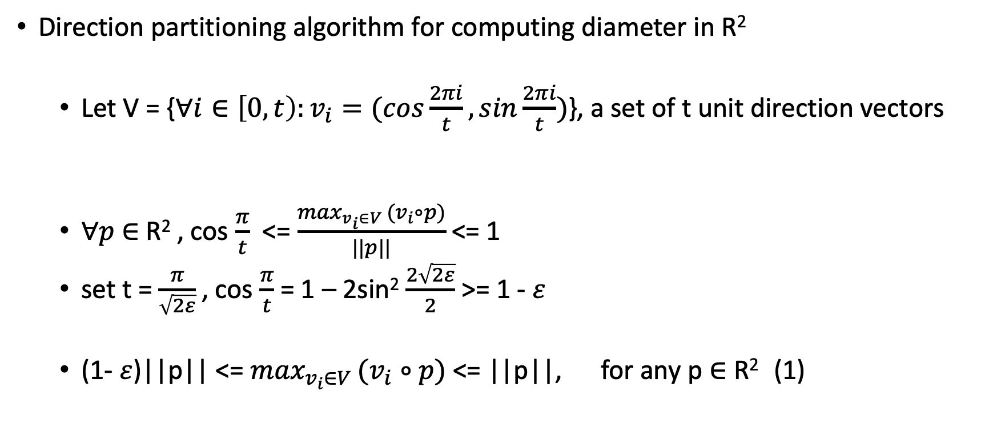
Diameter problem
Direction partitioning algorithm for computing diameter in R²
Let V = {$∀i∈\left[0,t\right):v_{i}=(cos\frac{2πi}{t},sin\frac{2πi}{t})$}, a set of t unit direction vectors
$∀p$ $∈$ R² , cos $\frac{π}{t}$ <= $\frac{\max_{v_{i}∈V }(v_{i}∘p)}{||p||}$<= 1
set t = $\frac{π}{\sqrt{2ε}}$, cos $\frac{π}{t}$ = 1 – 2sin² $\frac{2\sqrt{2ε}}{2}$ >= 1 - $ε$
(1- $ε$)||p|| <= $\max_{v_{i}∈V }(v_{i}∘p)$ <= ||p||, for any p $∈$ R² (1)

Slide 23

Diameter problem
Direction partitioning algorithm for computing diameter in R²
Given a finite set S of n points in R²
(1- $ε$)||p - q|| <= $\max_{v_{i}∈V }v_{i}∘\left(p−q\right)$ <= ||p-q|| (1)
Find ($\overline{v}$, $\overline{p}$, $\overline{q}$) such that $\overline{v}$ $∘\left(\overline{p}−\overline{q}\right)$ is maximal.

Slide 24
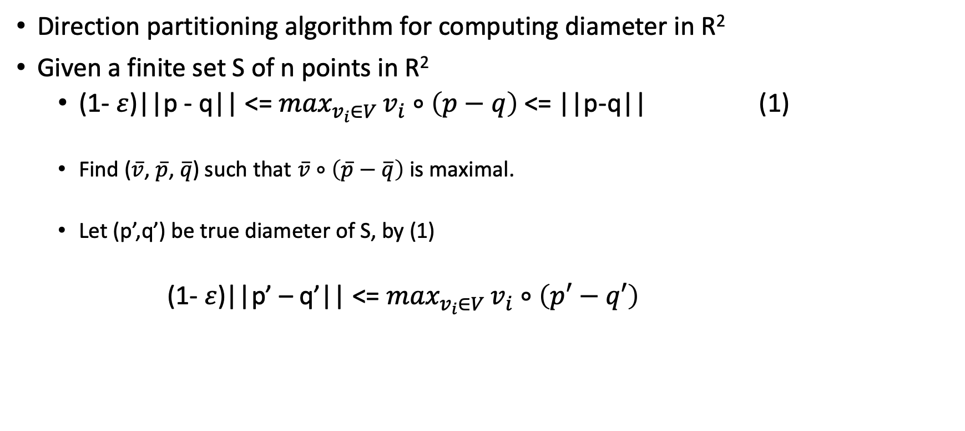
Diameter problem
Direction partitioning algorithm for computing diameter in R²
Given a finite set S of n points in R²
(1- $ε$)||p - q|| <= $\max_{v_{i}∈V }v_{i}∘\left(p−q\right)$ <= ||p-q|| (1)
Find ($\overline{v}$, $\overline{p}$, $\overline{q}$) such that $\overline{v}$ $∘\left(\overline{p}−\overline{q}\right)$ is maximal.
Let (p’,q’) be true diameter of S, by (1)
(1- $ε$)||p’ – q’|| <= $\max_{v_{i}∈V }v_{i}∘\left(p′−q′\right)$

Slide 25
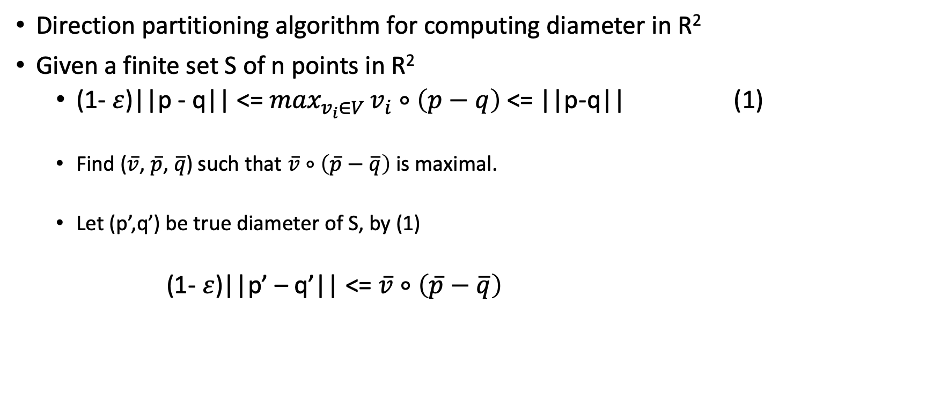
Diameter problem
Direction partitioning algorithm for computing diameter in R²
Given a finite set S of n points in R²
(1- $ε$)||p - q|| <= $\max_{v_{i}∈V }v_{i}∘\left(p−q\right)$ <= ||p-q|| (1)
Find ($\overline{v}$, $\overline{p}$, $\overline{q}$) such that $\overline{v}$ $∘\left(\overline{p}−\overline{q}\right)$ is maximal.
Let (p’,q’) be true diameter of S, by (1)
(1- $ε$)||p’ – q’|| <= $\overline{v}$ $∘\left(\overline{p}−\overline{q}\right)$

Slide 26
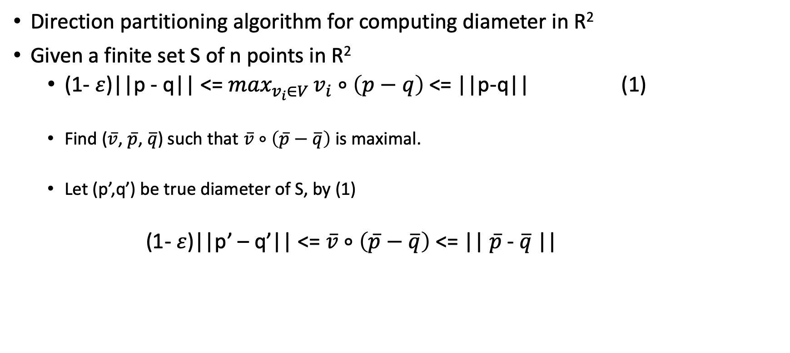
Diameter problem
Direction partitioning algorithm for computing diameter in R²
Given a finite set S of n points in R²
(1- $ε$)||p - q|| <= $\max_{v_{i}∈V }v_{i}∘\left(p−q\right)$ <= ||p-q|| (1)
Find ($\overline{v}$, $\overline{p}$, $\overline{q}$) such that $\overline{v}$ $∘\left(\overline{p}−\overline{q}\right)$ is maximal.
Let (p’,q’) be true diameter of S, by (1)
(1- $ε$)||p’ – q’|| <= $\overline{v}$ $∘\left(\overline{p}−\overline{q}\right)$ <= || $\overline{p}$- $\overline{q}$||

Slide 27
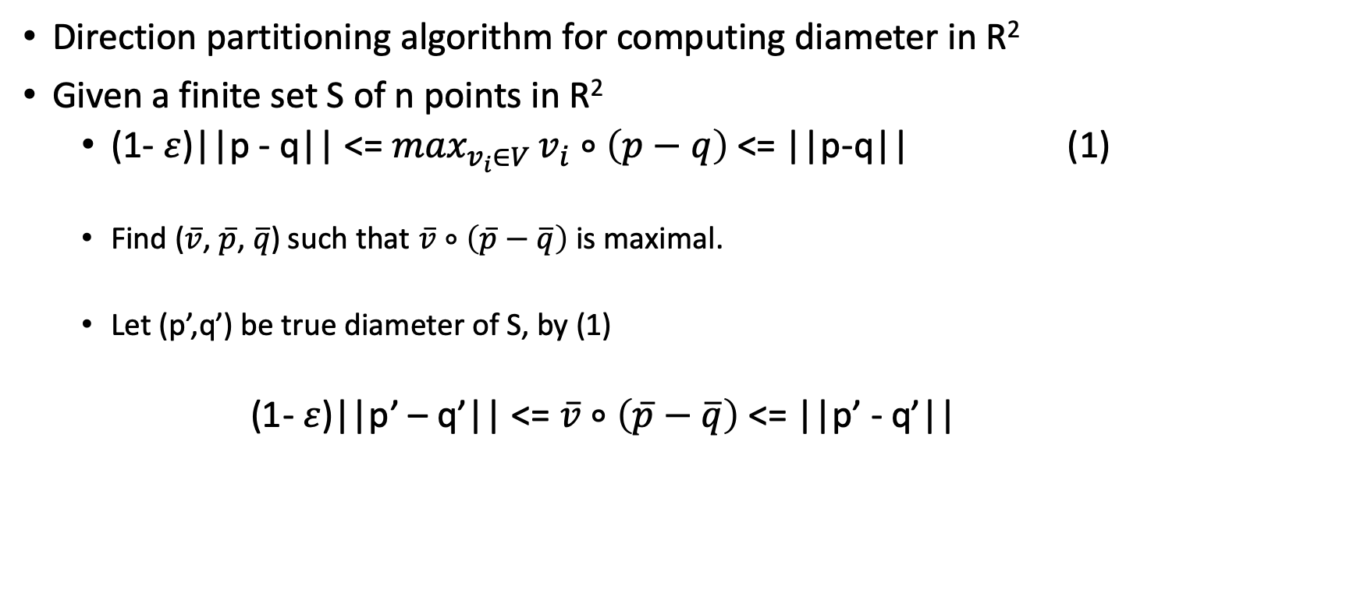
Diameter problem
Direction partitioning algorithm for computing diameter in R²
Given a finite set S of n points in R²
(1- $ε$)||p - q|| <= $\max_{v_{i}∈V }v_{i}∘\left(p−q\right)$ <= ||p-q|| (1)
Find ($\overline{v}$, $\overline{p}$, $\overline{q}$) such that $\overline{v}$ $∘\left(\overline{p}−\overline{q}\right)$ is maximal.
Let (p’,q’) be true diameter of S, by (1)
(1- $ε$)||p’ – q’|| <= $\overline{v}$ $∘\left(\overline{p}−\overline{q}\right)$ <= ||p’ - q’||

Slide 28
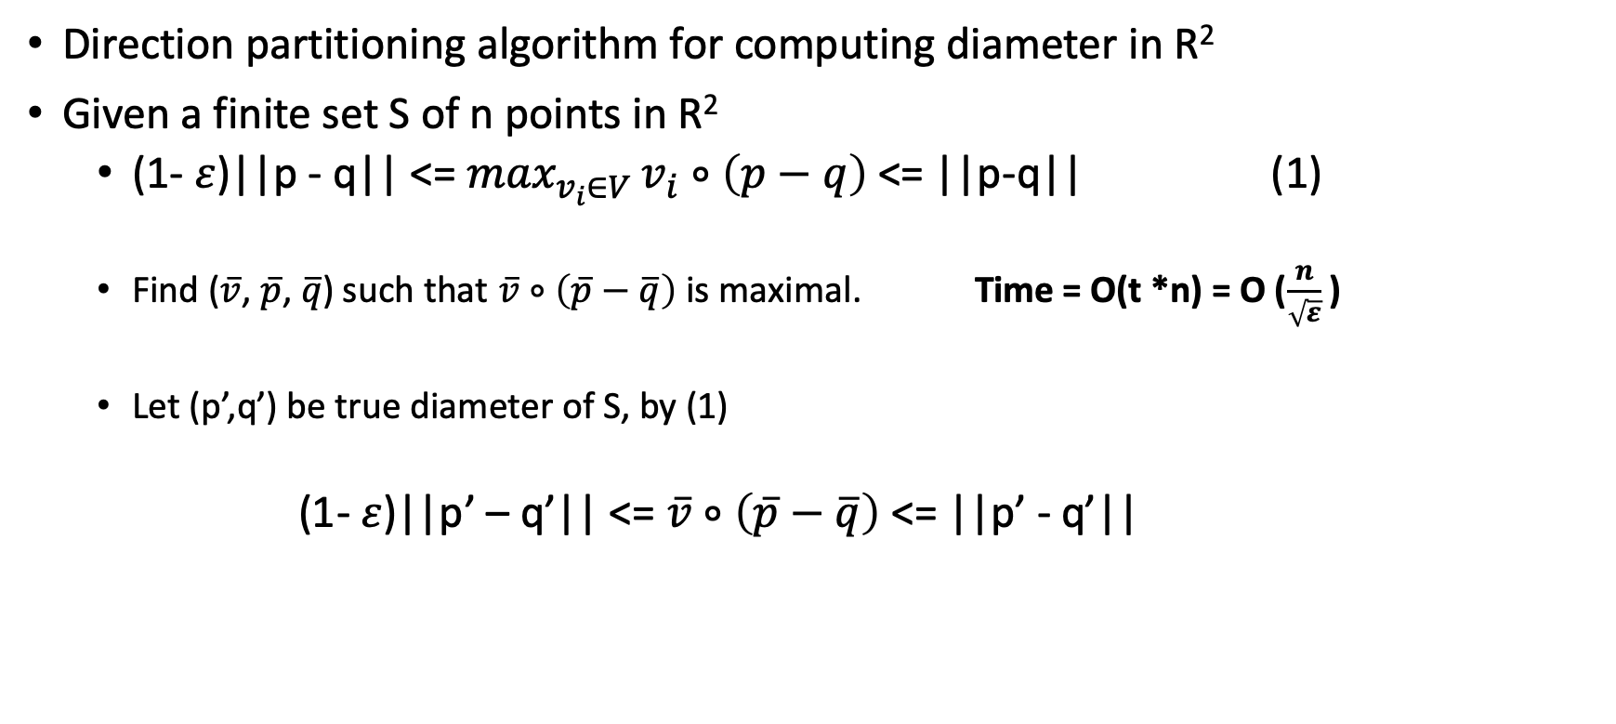
Diameter problem
Direction partitioning algorithm for computing diameter in R²
Given a finite set S of n points in R²
(1- $ε$)||p - q|| <= $\max_{v_{i}∈V }v_{i}∘\left(p−q\right)$ <= ||p-q|| (1)
Find ($\overline{v}$, $\overline{p}$, $\overline{q}$) such that $\overline{v}$ $∘\left(\overline{p}−\overline{q}\right)$ is maximal. Time = O(t *n) = O ($\frac{n}{\sqrt{ε}}$ )
Let (p’,q’) be true diameter of S, by (1)
(1- $ε$)||p’ – q’|| <= $\overline{v}$ $∘\left(\overline{p}−\overline{q}\right)$ <= ||p’ - q’||

Slide 29
Diameter problem
Direction partitioning algorithm for computing diameter in R^{d}
Given a finite set S of n points in R^{d}

Slide 30
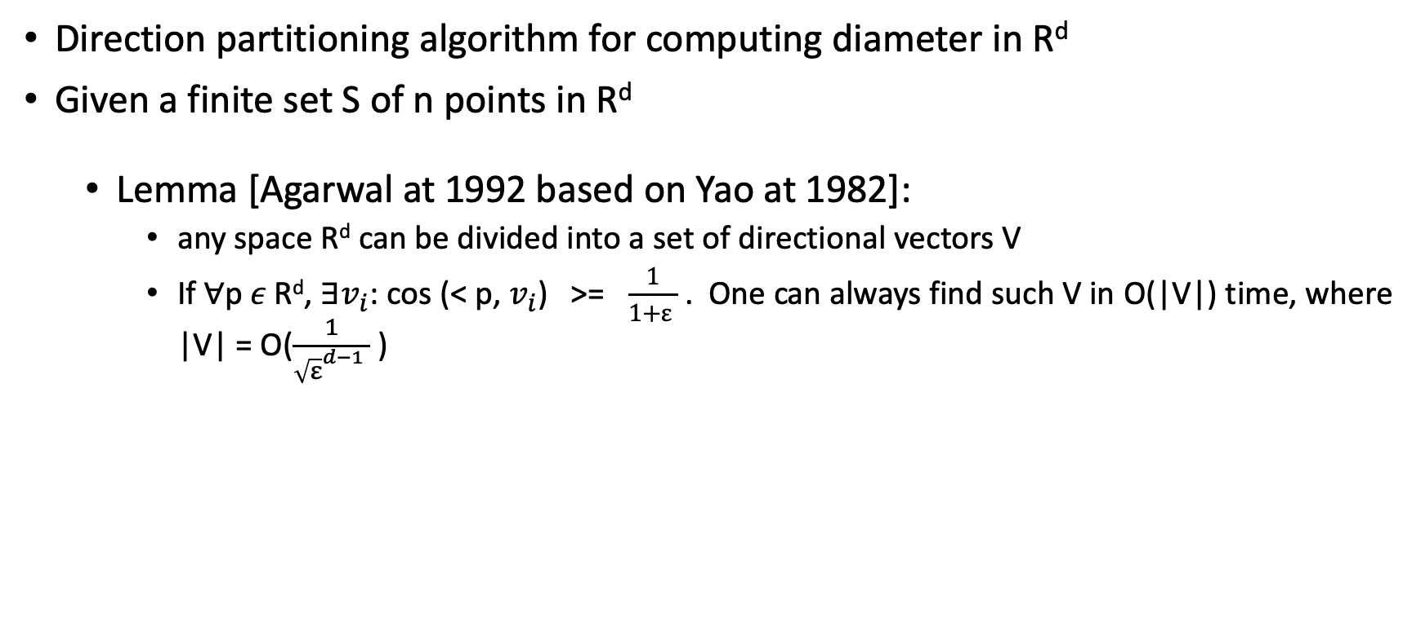
Diameter problem
Direction partitioning algorithm for computing diameter in R^{d}
Given a finite set S of n points in R^{d}
Lemma [Agarwal at 1992 based on Yao at 1982]:
any space R^{d} can be divided into a set of directional vectors V
If $∀$p$ε \text{R}\text{d}$, $∃v_{i}$: cos (< p, $v_{i}$) >= $\frac{1}{1+ε }$ . One can always find such V in O(|V|) time, where |V| = O($\frac{1}{{\sqrt{ε}}^{d−1} }$ )

Slide 31
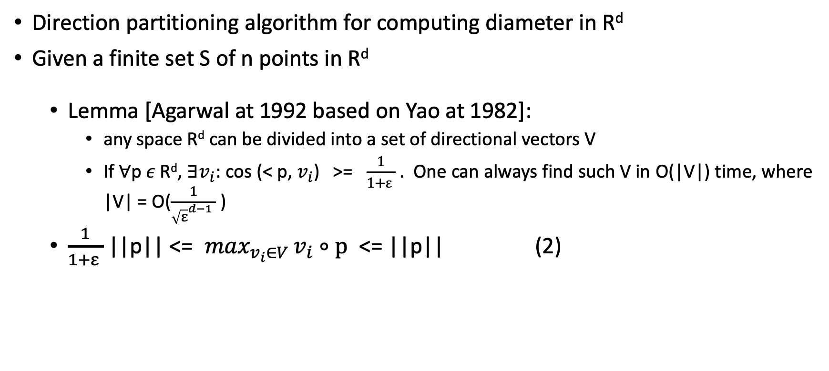
Diameter problem
Direction partitioning algorithm for computing diameter in R^{d}
Given a finite set S of n points in R^{d}
Lemma [Agarwal at 1992 based on Yao at 1982]:
any space R^{d} can be divided into a set of directional vectors V
If $∀$p$ε \text{R}\text{d}$, $∃v_{i}$: cos (< p, $v_{i}$) >= $\frac{1}{1+ε }$ . One can always find such V in O(|V|) time, where |V| = O($\frac{1}{{\sqrt{ε}}^{d−1} }$ )
$\frac{1}{1+ε }$ ||p|| <= $\max_{v_{i}∈V }v_{i}∘p$ <= ||p|| (2)

Slide 32
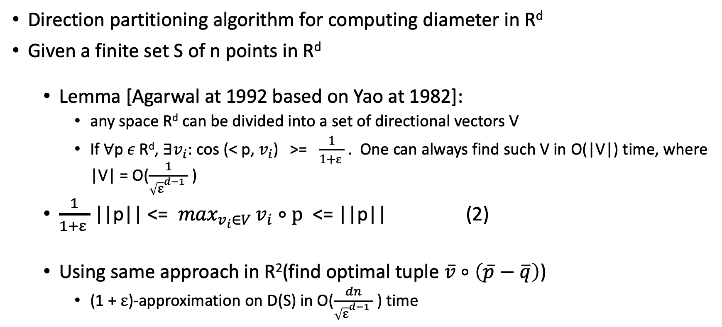
Diameter problem
Direction partitioning algorithm for computing diameter in R^{d}
Given a finite set S of n points in R^{d}
Lemma [Agarwal at 1992 based on Yao at 1982]:
any space R^{d} can be divided into a set of directional vectors V
If $∀$p$ε \text{R}\text{d}$, $∃v_{i}$: cos (< p, $v_{i}$) >= $\frac{1}{1+ε }$ . One can always find such V in O(|V|) time, where |V| = O($\frac{1}{{\sqrt{ε}}^{d−1} }$ )
$\frac{1}{1+ε }$ ||p|| <= $\max_{v_{i}∈V }v_{i}∘p$ <= ||p|| (2)
Using same approach in R²(find optimal tuple $\overline{v}$ $∘\left(\overline{p}−\overline{q}\right)$)
(1 + $ε$)-approximation on D(S) in O($\frac{dn}{{\sqrt{ε}}^{d−1} }$ ) time

Slide 33

Diameter problem
Dimension Reduction in R^{d} [Chan at 2002]
$\frac{1}{1+ε }$ ||p|| <= $\max_{v_{i}∈V }v_{i}∘p$ <= ||p||, for any p $∈$ R^{d} (2)

Slide 34

Diameter problem
Dimension Reduction in R^{d} [Chan at 2002]
$\frac{1}{1+ε }$ ||p|| <= $\max_{v_{i}∈V }v_{i}∘p$ <= ||p||, for any p $∈$ R^{d} (2)
($\frac{1}{1+ε })$² ($p_{1}^{2}$+ $p_{2}^{2}$) <= $\max_{v_{i}∈V }{(v}_{1}∗p_{1}$ + $v_{2}∗p_{2})$²<= ($p_{1}^{2}$+ $p_{2}^{2}$) Only look at 2 dimensions (3)
add terms $p_{3}^{2}$+ $p_{4}^{2}$ …. + $p_{d}^{2}$ to (3)

Slide 35
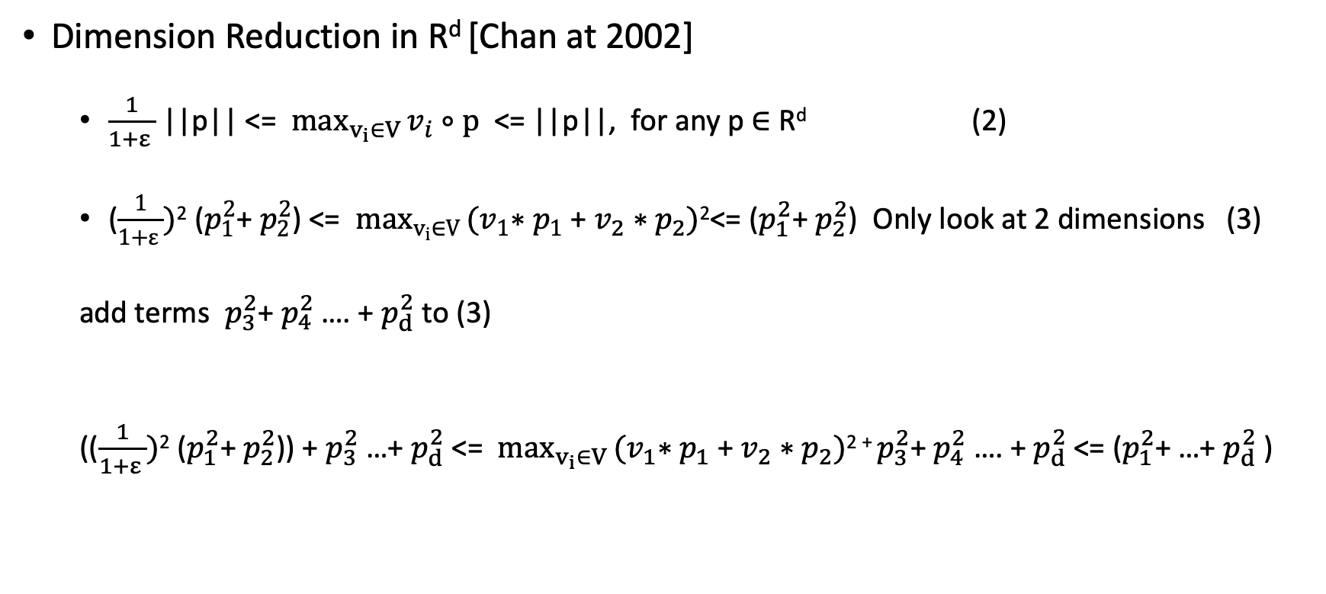
Diameter problem
Dimension Reduction in R^{d} [Chan at 2002]
$\frac{1}{1+ε }$ ||p|| <= $\max_{v_{i}∈V }v_{i}∘p$ <= ||p||, for any p $∈$ R^{d} (2)
($\frac{1}{1+ε })$² ($p_{1}^{2}$+ $p_{2}^{2}$) <= $\max_{v_{i}∈V }{(v}_{1}∗p_{1}$ + $v_{2}∗p_{2})$²<= ($p_{1}^{2}$+ $p_{2}^{2}$) Only look at 2 dimensions (3)
add terms $p_{3}^{2}$+ $p_{4}^{2}$ …. + $p_{d}^{2}$ to (3)
(($\frac{1}{1+ε })$² ($p_{1}^{2}$+ $p_{2}^{2}$)) + $p_{3}^{2}$ …+ $p_{d}^{2}$<= $\max_{v_{i}∈V }{(v}_{1}∗p_{1}$ + $v_{2}∗p_{2})$² ⁺ $p_{3}^{2}$+ $p_{4}^{2}$ …. + $p_{d}^{2}$<= ($p_{1}^{2}$+ …+ $p_{d}^{2}$)

Slide 36
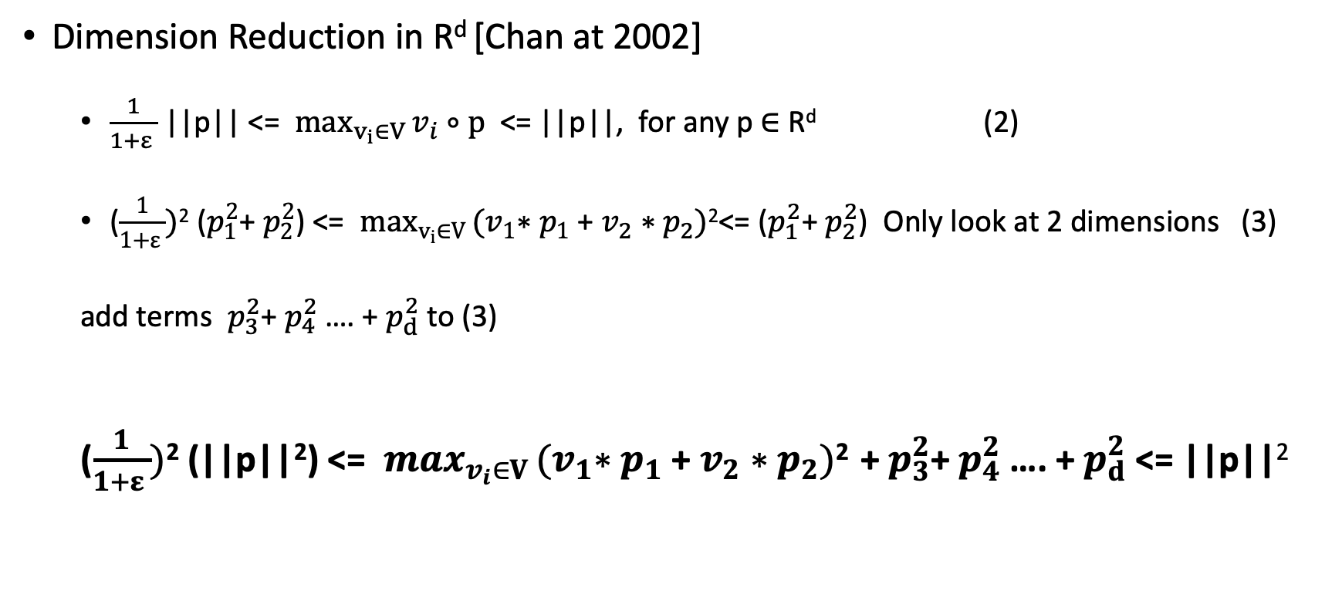
Diameter problem
Dimension Reduction in R^{d} [Chan at 2002]
$\frac{1}{1+ε }$ ||p|| <= $\max_{v_{i}∈V }v_{i}∘p$ <= ||p||, for any p $∈$ R^{d} (2)
($\frac{1}{1+ε })$² ($p_{1}^{2}$+ $p_{2}^{2}$) <= $\max_{v_{i}∈V }{(v}_{1}∗p_{1}$ + $v_{2}∗p_{2})$²<= ($p_{1}^{2}$+ $p_{2}^{2}$) Only look at 2 dimensions (3)
add terms $p_{3}^{2}$+ $p_{4}^{2}$ …. + $p_{d}^{2}$ to (3)
($\frac{1}{1+ε })$² (||p||²) <= $\max_{v_{i}∈V }{(v}_{1}∗p_{1}$ + $v_{2}∗p_{2})$² +$p_{3}^{2}$+ $p_{4}^{2}$ …. + $p_{d}^{2}$<= ||p||²

Slide 37

Diameter problem
Dimension Reduction in R^{d} [Chan at 2002]
($\frac{1}{1+ε })$² (||p||²) <= $\max_{v_{i}∈V }{(v}_{1}∗p_{1}$ + $v_{2}∗p_{2})$² +$p_{3}^{2}$+ $p_{4}^{2}$ …. + $p_{d}^{2}$<= ||p||²

Slide 38
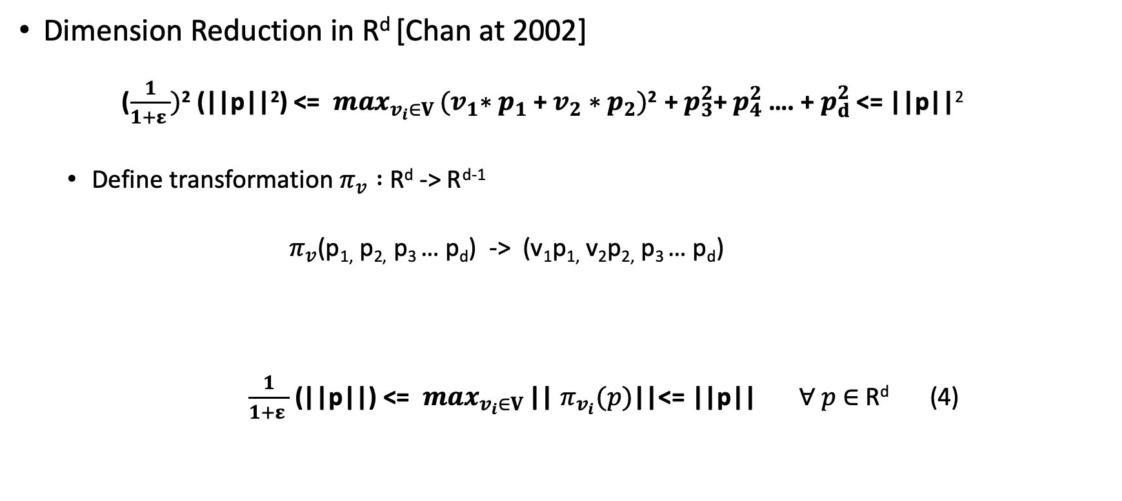
Diameter problem
Dimension Reduction in R^{d} [Chan at 2002]
($\frac{1}{1+ε })$² (||p||²) <= $\max_{v_{i}∈V }{(v}_{1}∗p_{1}$ + $v_{2}∗p_{2})$² +$p_{3}^{2}$+ $p_{4}^{2}$ …. + $p_{d}^{2}$<= ||p||²
Define transformation $π_{v} :$R^{d} -> R^{d-1}
$π_{v}$(p_{1,} p_{2,} p₃ … p_{d}) -> (v₁p_{1,} v₂p_{2,} p₃ … p_{d})
$\frac{1}{1+ε }$ (||p||) <= $\max_{v_{i}∈V }$|| $π_{v_{i}}(p)$||<= ||p|| $∀ p$ $∈$R^{d} (4)

Slide 39

Diameter problem
Dimension Reduction in R^{d} [Chan at 2002]
$\frac{1}{1+ε }$ (||p-q||) <= $\max_{v_{i}∈V }$|| $π_{v_{i}}(p−q)$||<= ||p-q|| $∀ p$,q $∈$R^{d} (4)

Slide 40
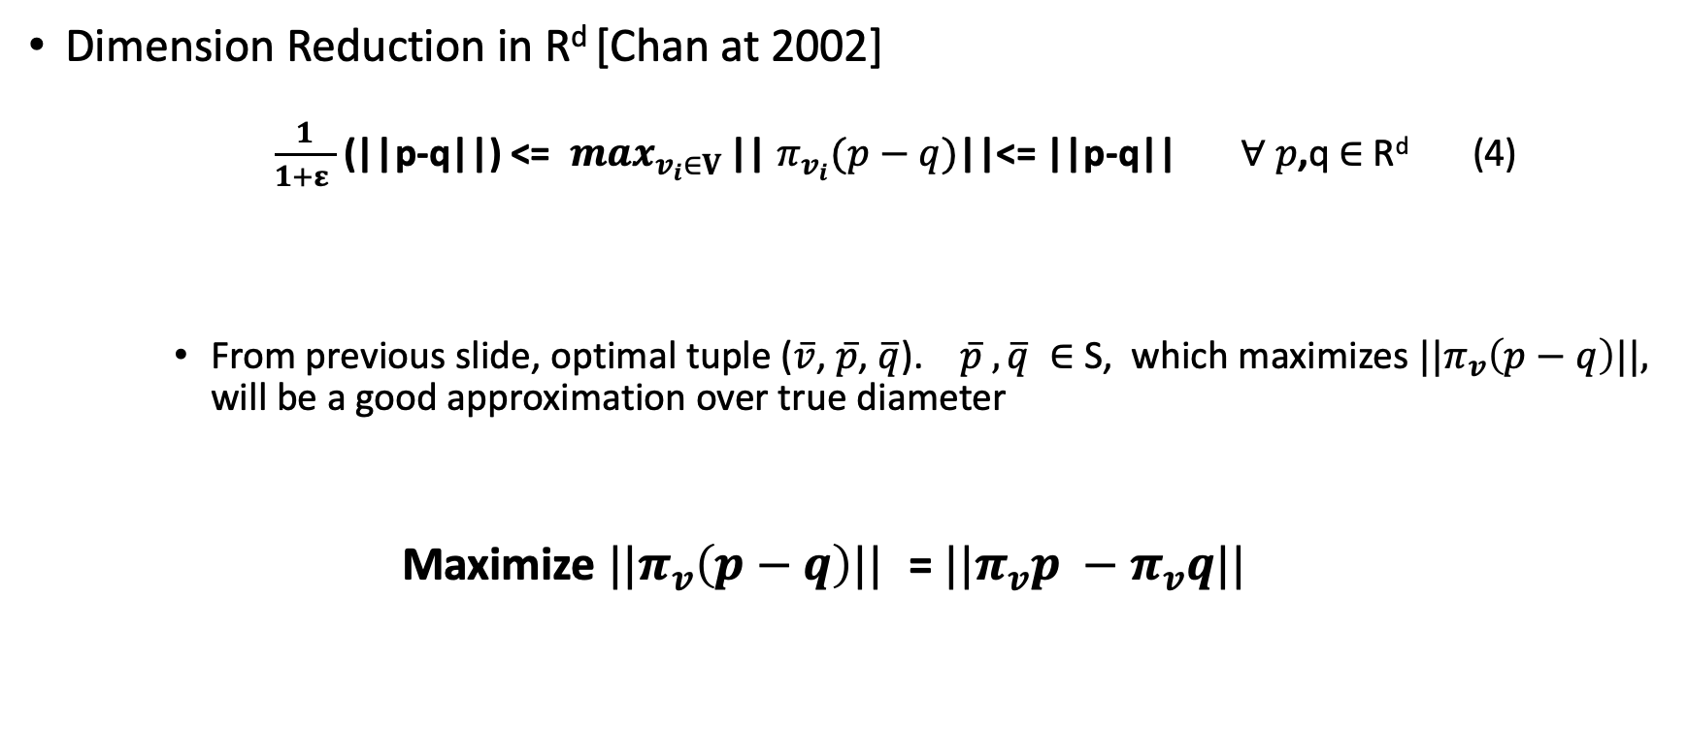
Diameter problem
Dimension Reduction in R^{d} [Chan at 2002]
$\frac{1}{1+ε }$ (||p-q||) <= $\max_{v_{i}∈V }$|| $π_{v_{i}}(p−q)$||<= ||p-q|| $∀ p$,q $∈$R^{d} (4)
From previous slide, optimal tuple ($\overline{v}$, $\overline{p}$, $\overline{q}$). $\overline{p}$ $,\overline{q} ∈$S, which maximizes ${||π}_{v}\left(p−q\right)||,$ will be a good approximation over true diameter
Maximize ${||π}_{v}\left(p−q\right)||$ = ${||π}_{v}p −π_{v}q||$

Slide 41

Diameter problem
Dimension Reduction in R^{d} [Chan at 2002]
Step1: break unit sphere(circle) into t parts. Form a set V of direction vectors.
V = {$∀i∈\left[0,t\right):v_{i}=(cos\frac{2πi}{t},sin\frac{2πi}{t})$}

Slide 42

Diameter problem
Dimension Reduction in R^{d} [Chan at 2002]
Step1: break unit sphere(circle) into t parts. Form a set V of direction vectors.
V = {$∀i∈\left[0,t\right):v_{i}=(cos\frac{2πi}{t},sin\frac{2πi}{t})$}
Step2: Find ($\overline{v}$, $\overline{p}$, $\overline{q}$) such that $\overline{v}$ $∘\left(\overline{p}−\overline{q}\right)$ is maximal. Do this recursively for each $v_{i}$ $∈$ V

Slide 43
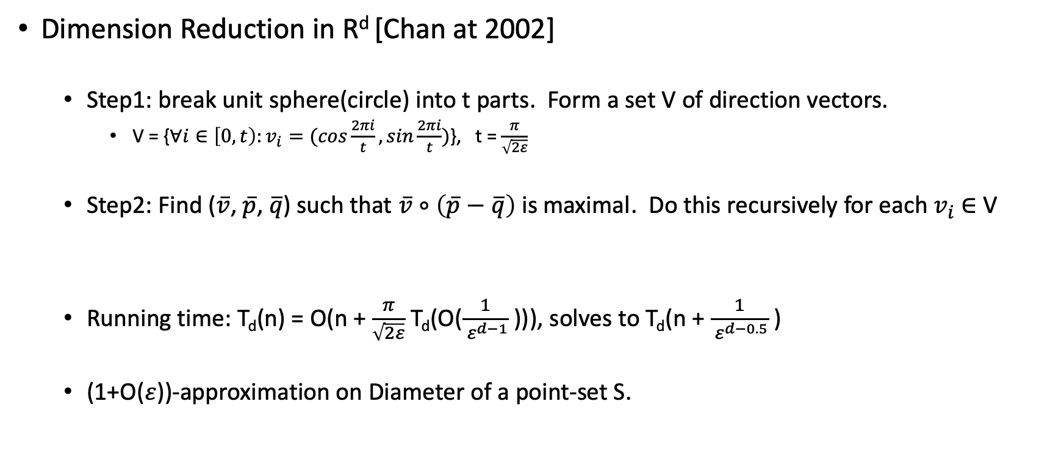
Diameter problem
Dimension Reduction in R^{d} [Chan at 2002]
Step1: break unit sphere(circle) into t parts. Form a set V of direction vectors.
V = {$∀i∈\left[0,t\right):v_{i}=(cos\frac{2πi}{t},sin\frac{2πi}{t})$}, t = $\frac{π}{\sqrt{2ε}}$
Step2: Find ($\overline{v}$, $\overline{p}$, $\overline{q}$) such that $\overline{v}$ $∘\left(\overline{p}−\overline{q}\right)$ is maximal. Do this recursively for each $v_{i}$ $∈$ V
Running time: T_{d}(n) = O(n + $\frac{π}{\sqrt{2ε}}$ T_{d}(O($\frac{1}{ ε^{d−1}}$ ))), solves to T_{d}(n + $\frac{1}{ ε^{d−0.5}}$ )
(1+O($ε$))-approximation on Diameter of a point-set S.

Slide 44

Diameter problem
(1+$ε$)-approximation Algorithm [Mahdi Imanparast, Seyed Naser Hashmi, Ali Mohades].
Given Given a finite set S of n points in R^{d}, an error parameter $ε$
D(S)

Slide 45
Diameter problem
(1+$ε$)-approximation Algorithm [Mahdi Imanparast, Seyed Naser Hashmi, Ali Mohades].
Given Given a finite set S of n points in R^{d}, an error parameter $ε$
D(S)

Slide 46
Diameter problem
(1+$ε$)-approximation Algorithm [Mahdi Imanparast, Seyed Naser Hashmi, Ali Mohades].
Given Given a finite set S of n points in R^{d}, an error parameter $ε$
D(S)

